Slide 1
Head of the class
Name : Wenxu Kang 300943385
Wen Ma 300903179

Slide 2



Slide 3


Slide 4
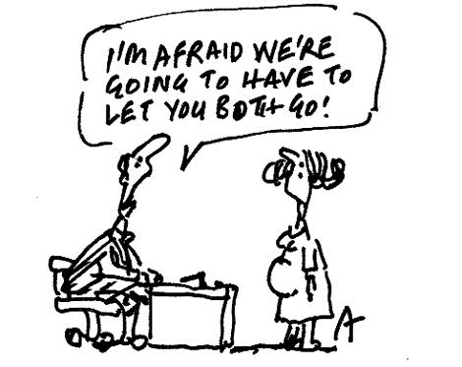

Slide 5


Slide 6


Slide 7


Slide 8


Slide 9


Slide 10
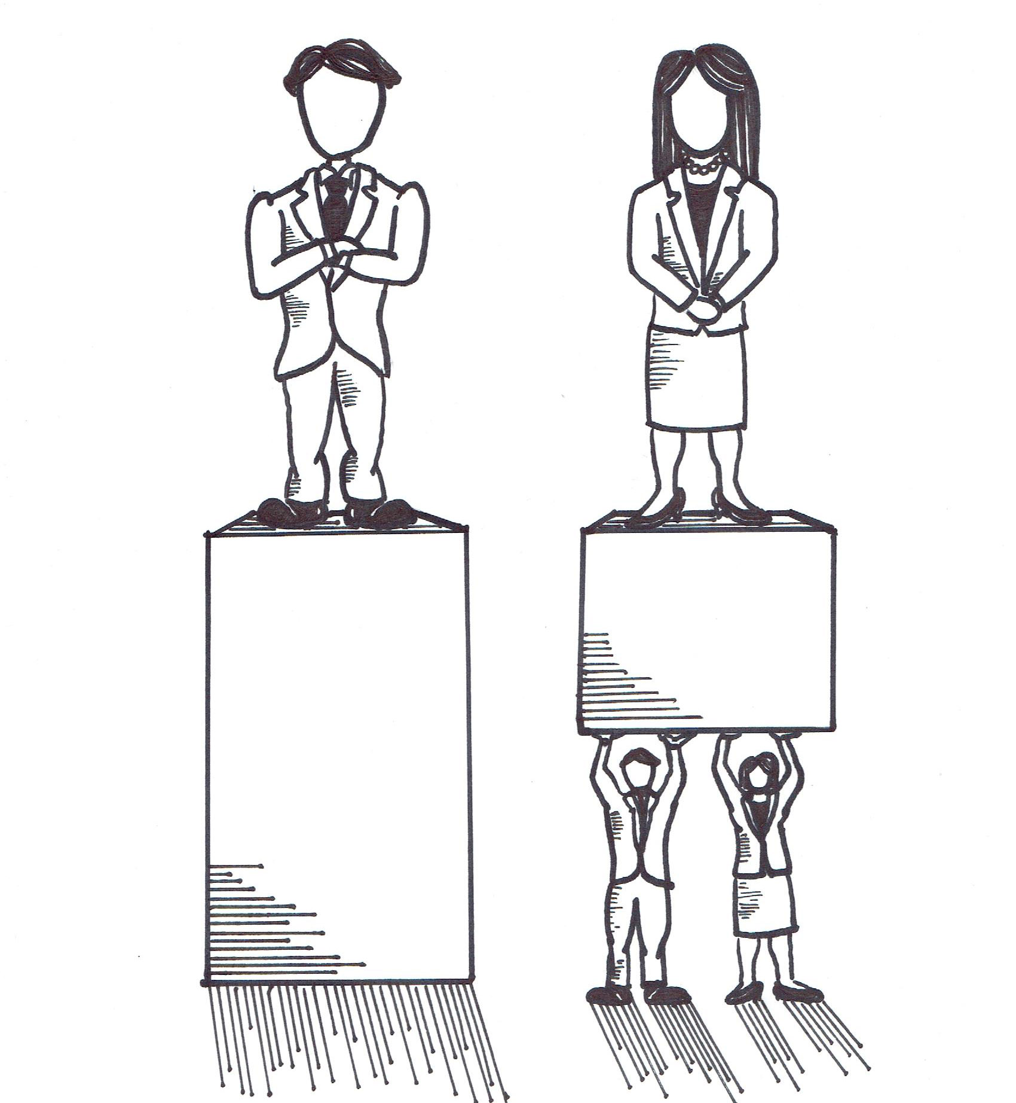

Slide 11


Slide 12
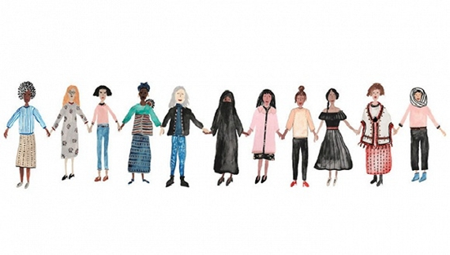

Slide 13
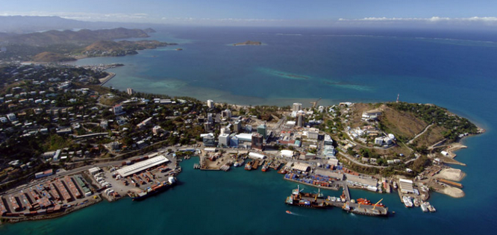
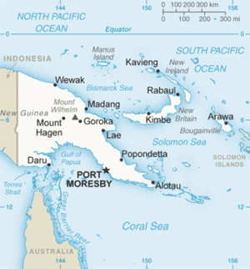


Slide 14



Slide 15
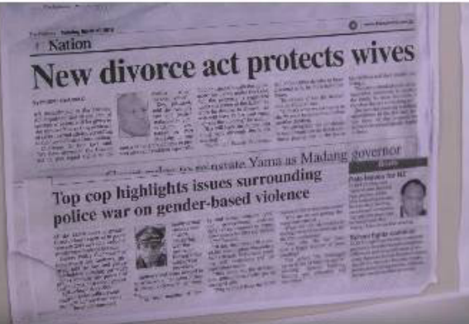

Slide 16
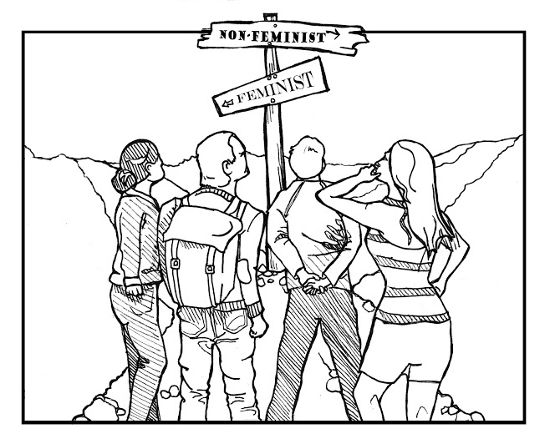

Slide 17
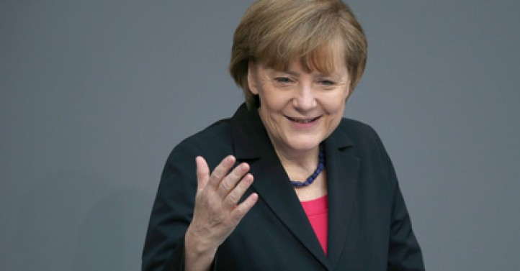


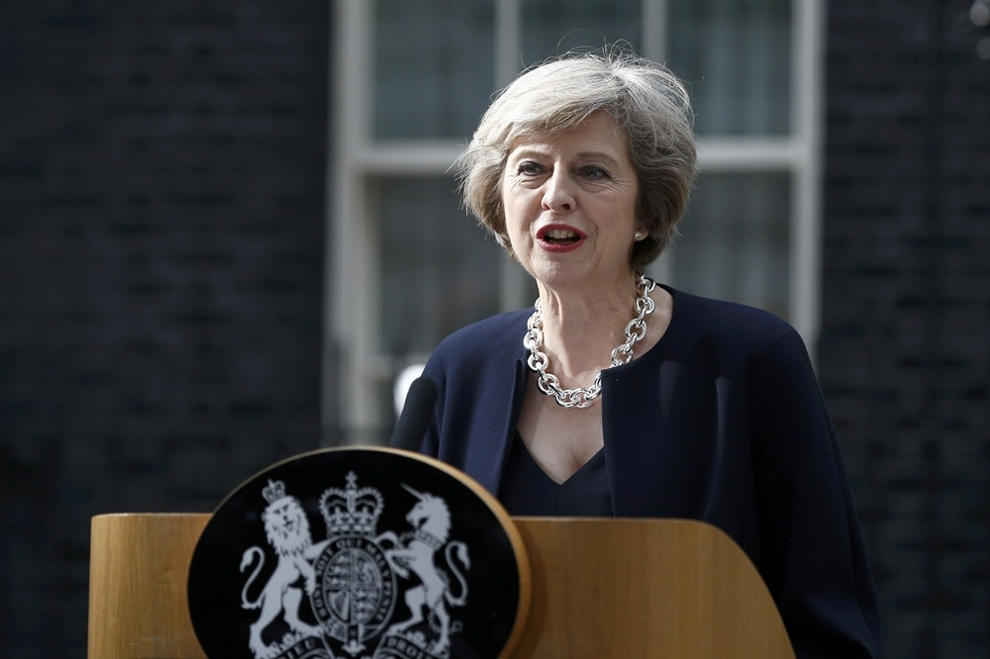

Slide 18
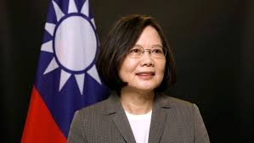


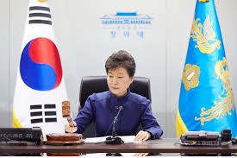

Slide 19


Slide 20

Can female hold high administrative position and will have a family life?

